Slide 1
Intro to Node.js

Slide 2
Today’s Agenda
Introduction to Node.js!!

Slide 3
Modules
Web page structure and appearance with HTML5 and CSS.
Client-side interactivity with JS DOM and events.
Using web services (API's) as a client with JS.
Writing JSON-based web services with a server-side language.
Storing and retrieving information in a database with MySQL and server-side programs.

Slide 4
Review: Web Service
Web service: software functionality that can be invoked through the internet using common protocols
It's like a remote function(s) you can call. Done by contacting a program on a web server
Web services can be written in a variety of languages
Many web services accept parameters and produce results
Clients contact the server through the browser using XML over HTTP and/or AJAX Fetch code
The service's output might be HTML but could be text, XML, JSON, or other content

Slide 5
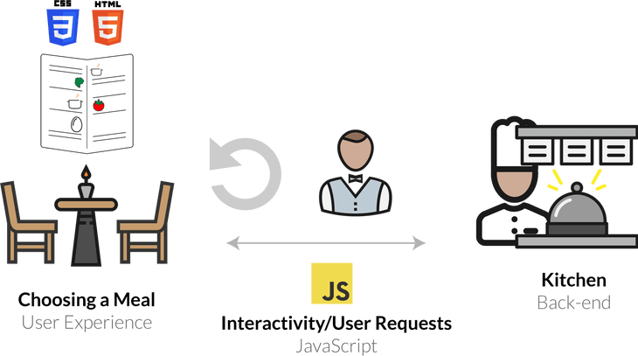
So How Does a Web Service Respond to Requests

Slide 6
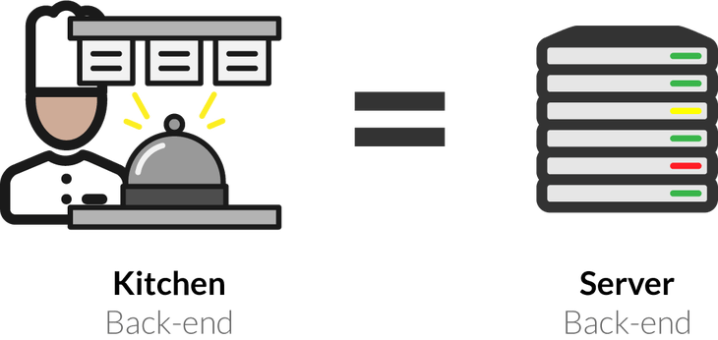
Why Do We Need a Server to Handle Web Service Requests?
Servers are dedicated computers for processing data efficiently and delegating requests sent from many clients (often at once).
These tasks are not possible (or appropriate) in the client's browser.

Slide 7
Creating our own API

Slide 8

Our (New) Server-Side Language: JS (Node)
Open-source with an active developer community
Flourishing package ecosystem
Designed for efficient, asynchronous server-side programming

Slide 9
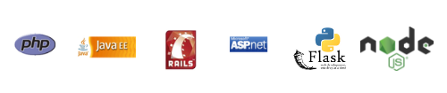
Languages for Server-Side Programming
Server-side programs are written using programming languages/frameworks such as PHP, Java/JSP, Ruby on Rails, ASP.NET, Python, Perl, JS (Node.js), and many, many more
Web servers contain software to run those programs and send back their output.

Slide 10
What is Client-Side JS?
So far, we have used JS on the browser (client) to add interactivity to our web pages
"Under the hood", your browser requests the JS (and other files) from a URL resource, loads the text file of the JS, and interprets it realtime in order to define how the web page behaves.
In Chrome, it does this using the V8 JavaScript engine, which is an open-source JS interpreter made by Google. Other browsers have different JS engines (e.g. Firefox uses SpiderMonkey).
Besides the standard JS language features, you also have access to the DOM when running JS on the browser - this includes the window and document

Slide 11
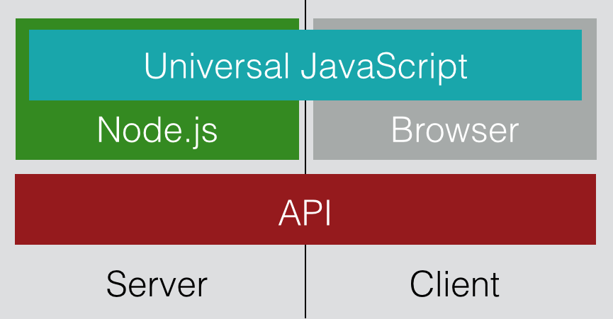
Client vs. Server-side JS

Slide 12
Node.js: Server-side JS
Node.js uses the same open-source V8 JavaScript engine as Chrome
Node.js is a runtime environment for running JS programs using the same core language features, but outside of the browser.
When using Node, you do not have access to the browser objects/functions (e.g. document, window, addEventListener).
Instead, you have access to functionality for managing HTTP requests, file i/o, and database interaction.
This functionality is key to building REST APIs!

Slide 13
Getting started with Node.js
When you have Node installed (this week's section), you can run it immediately in the command line.
Start an interactive REPL with node (no arguments). This REPL is much like the Chrome browser's JS console tab.
Execute a JS program in the current directory with node file.js

Slide 14
Starting a Node.js Project
There are a few steps to starting a Node.js application, but luckily most projects will follow the same structure.
When using Node.js, you will mostly be using the command line
Start a new project directory (e.g. node-practice)
Inside the directory, run npm init to initialize a package.json configuration file (you can keep pressing Enter to use defaults)
Install any modules with npm install <package-name>
Write your Node.js file! (e.g. app.js)
Include any front-end files in a public directory within the project.
Along the way, a tool called npm will help install and manage packages that are useful in your Node app.

Slide 15
Starting a Node.js Project
Run npm init to create package.json

Slide 16
Starting a Node.js Project
Run npm install express to install the Express.js package

Slide 17
Starting app.js
Build your basic app:
"use strict";
const express = require('express');
const app = express();
app.get('/posts', function (req, res) {
res.type("text").send("Hello World");
});
app.listen(8080);

Slide 18
Node.js Modules
When you run a .js file using Node.js, you have access to default functions in JS (e.g. console.log)
In order to get functionality like file i/o or handling network requests, you need to import that functionality from modules - this is similar to the import keyword you have used in Java or Python.
In Node.js, you do this by using the require() function, passing the string name of the module you want to import.
For example, the module we'll use to respond to HTTP requests in Node.js is called express. You can import it like this:
const express = require("express");

Slide 19
Quick reminder on const Keyword
Using const to declare a variable inside of JS just means that you can never change what that variable references. We've used this to represent "program constants" indicated by ALL_UPPERCASE naming conventions
For example, the following code would not work:
const specialNumber = 1;
specialNumber = 2; // TypeError: Assignment to constant variable.
When we store modules in Node programs, it is conventional to use const instead of let to avoid accidentally overwriting the module.
Unlike the program constants we define with const (e.g. BASE_URL), we use camelCase naming instead of ALL_CAPS.

Slide 20
app.listen()
To start the localhost server to run your Express app, you need to specify a port to listen to.
The express app object has a function app.listen which takes a port number and optional callback function
At the bottom of your app.js, add the following code - (process.env.PORT is needed to use the default port when hosted on an actual server)
// Allows us to change the port easily by setting an environment
// variable, so your app works with our grading software
const PORT = process.env.PORT || 8000;
app.listen(PORT);

Slide 21
Basic Routing in Express
Routes are used to define endpoints in your web service
Express supports different HTTP requests - we will learn GET and POST
Express will try to match routes in the order they are defined in your code

Slide 22
Adding Routes in Express.js
app.get(path, (req, res) => {
...
});
app.get allows us to create a GET endpoint. It takes two arguments: The endpoint URL path, and a callback function for modifying/sending the response.
req is the request object, and holds items like the request parameters.
res is the response object, and has methods to send data to the client.
res.set(...) sets header data, like "content-type". Always set either "text/plain" or "application/json" with your response.
res.send(response) returns the response as HTML text to the client.
res.json(response) Does the same, but with a JSON object.
When adding a route to the path, you will retrieve information from the request, and send back a response using res (e.g. setting the status code, content-type, etc.)
If the visited endpoint has no matching route in your Express app, the response will be a 404 (resource not found)

Slide 23
Useful Request Properties/Methods
Name | Description
req.params | Endpoint “path” parameters from the request
req.query | Query parameters from the request

Slide 24
Useful Response Properties/Methods
Name | Description
res.write(data) | Writes data in the response without ending the communication
res.end() | Ends the process
res.send() | Sends information back (default text with HTML content type)
res.json() | Sends information back as JSON content type
res.set() | Sets header information, such as "Content-type"
res.type() | A convenience function to set content type (use "text" for "text/plain", use "json" for "application/json")
res.status() | Sets the response status code
res.sendStatus() | Sets the response status code with the default status text

Slide 25
Setting the Content Type
By default, the content type of a response is HTML - we will only be sending plain text or JSON responses though in our web services
To change the content type, you can use the res.set function, which is used to set response header information (e.g. content type).
You can alternatively uses res.type("text") and res.type("json") which are equivalent to setting text/plain and application/json Content-Type headers, respectively.
app.get('/hello', function (req, res) {
// res.set("Content-Type", "text/plain");
res.type("text"); // same as above
res.send('Hello World!');
});
app.get('/hello', function (req, res) {
// res.set("Content-Type", "application/json");
res.json({ "msg" : "Hello world!" });
// can also do res.json({ "msg" : "Hello world!"});
// which also sets the content type to application/json
});

Slide 26
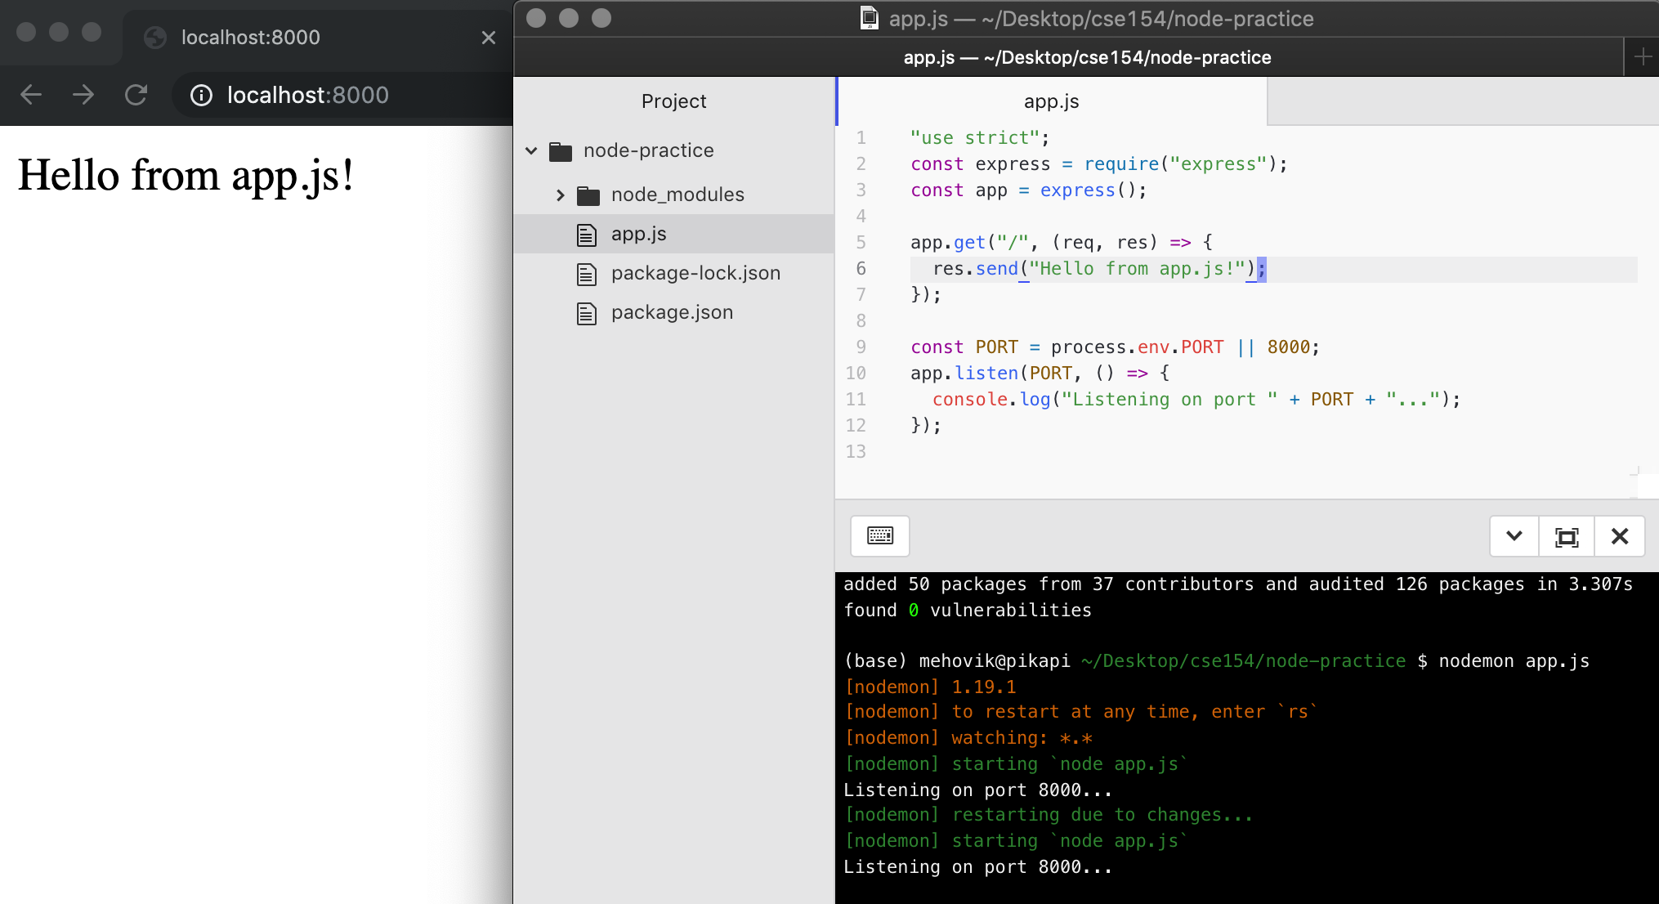
Adding our first “root” route
When you add a route in your Express app (here, we use '/' for the most basic "root" route), you can use res.send to send a response to the client (browser) and view using the port (here, 8000 on localhost)

Slide 27
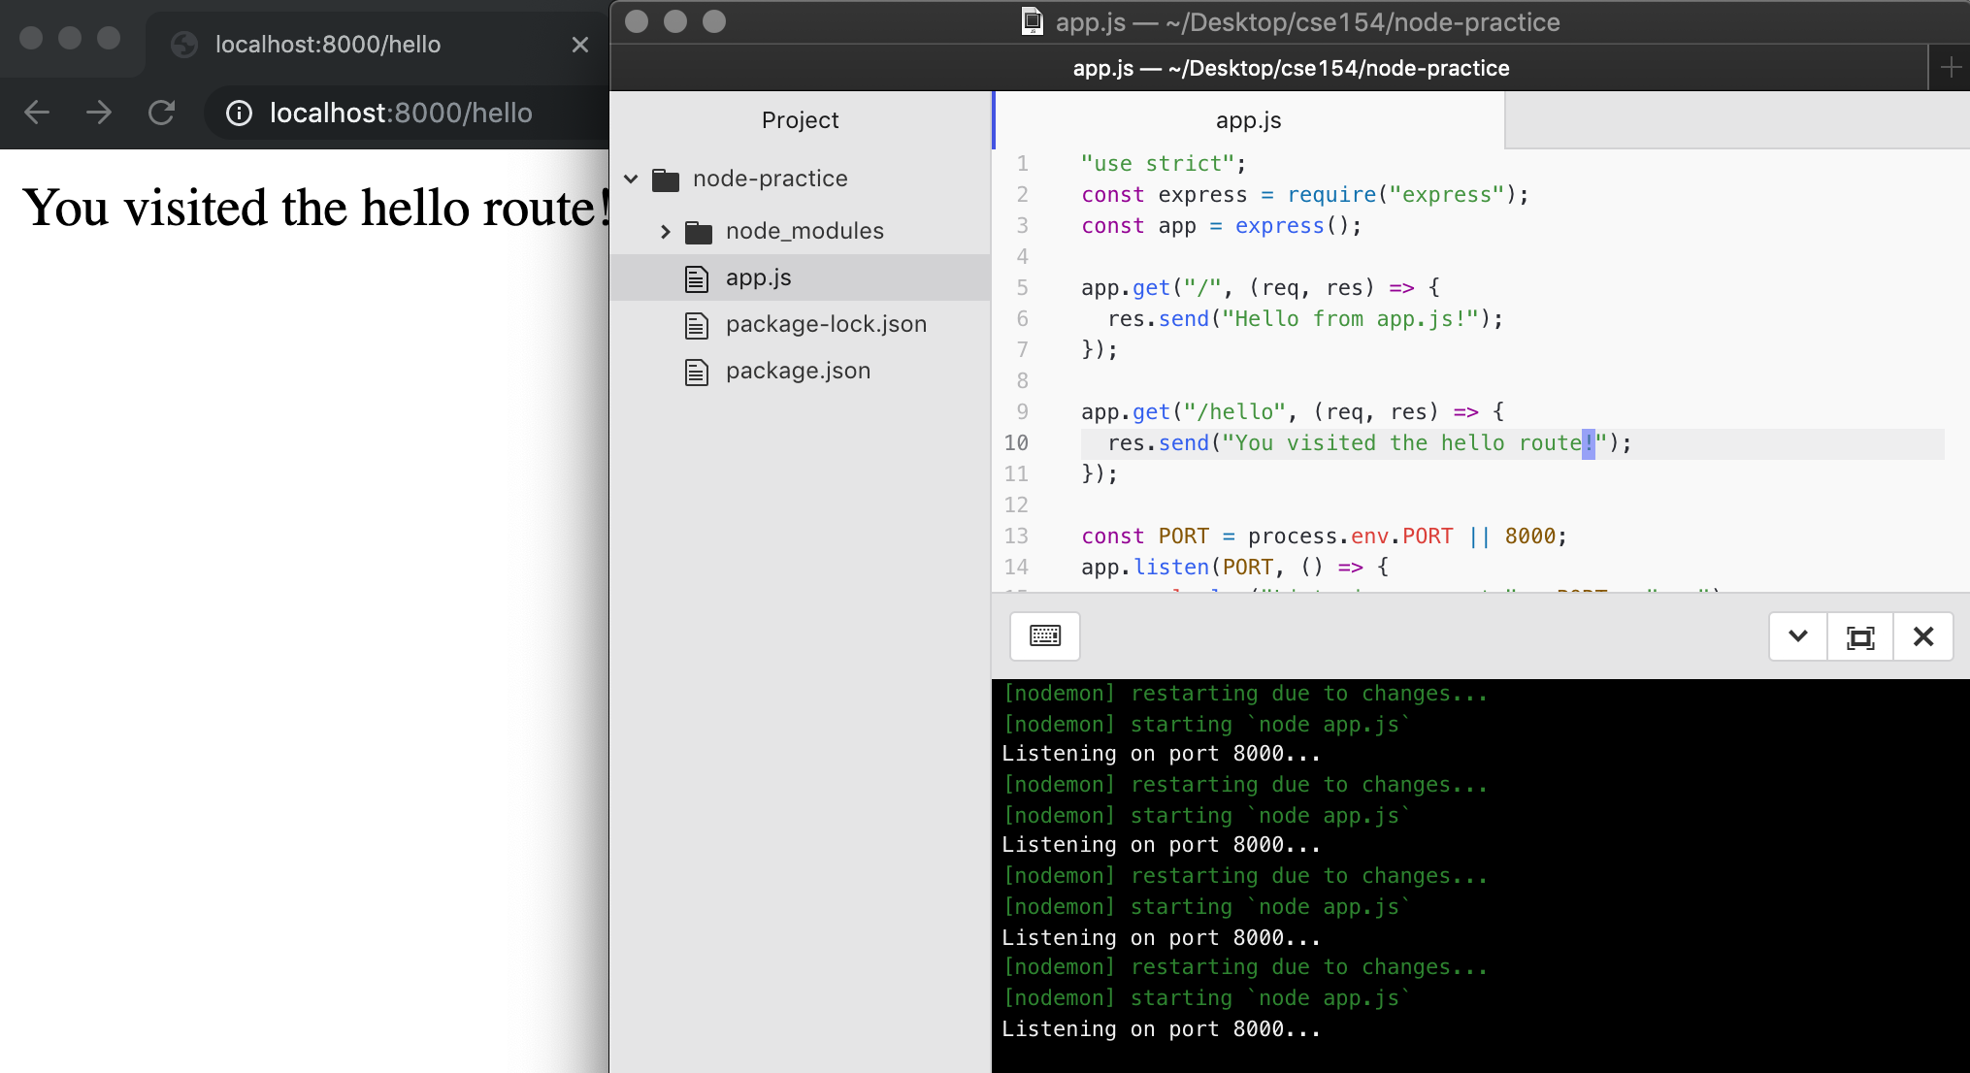
Adding another route
You can add more routes in your file, and Express will use the first one matching the request path

Slide 28
Request Parameters: Path Parameters
Act as wildcards in routes, letting a user pass in "variables" to an endpoint
Define a route parameter with :param
Route path: /states/:state/cities/:city
Request URL: http://localhost:8000/states/wa/cities/Seattle
req.params: { "state": "wa", "city": "Seattle" }
These are attached to the request object and can be accessed with req.params
app.get("/states/:state/cities/:city", function (req, res) {
res.type("text");
res.send("You sent a request for " + req.params.city + ", " + req.params.state);
});

Slide 29
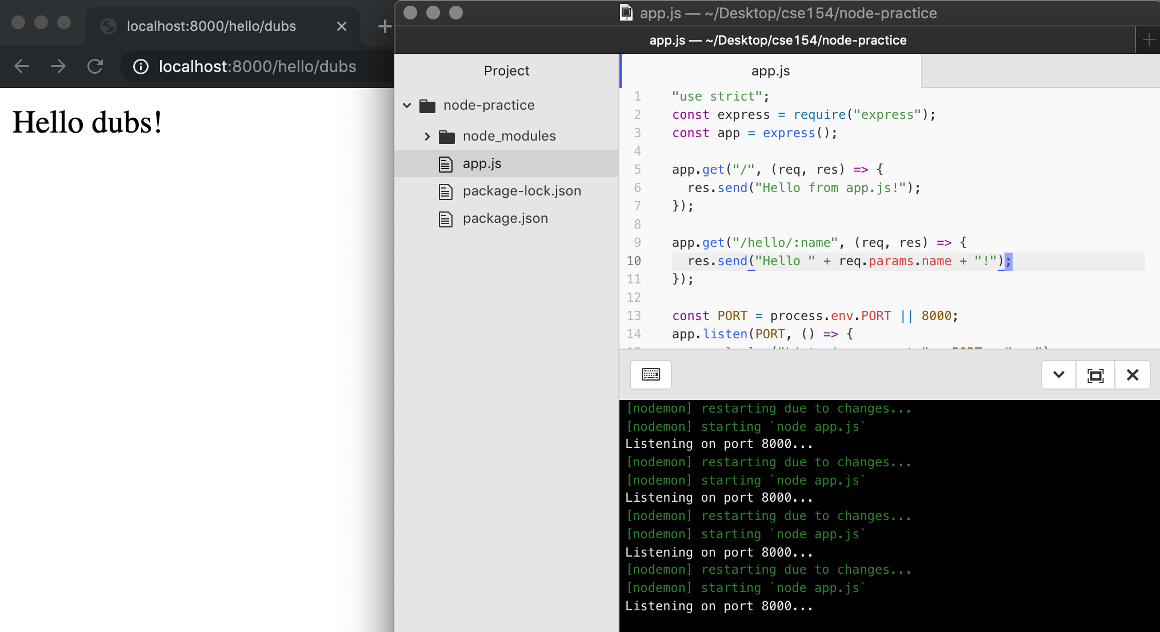
Adding route parameters: Example

Slide 30
Request Parameters: Path Parameters
You can also use query parameters in Express using the req.query object, though they are more useful for optional parameters.
Route path: /cityInfo
Request URL: http://localhost:8000/cityInfo?state=wa&city=Seattle
req.query: { "state": "wa", "city": "Seattle" }
app.get("/cityInfo", function (req, res) {
let state = req.query.state; // wa
let city = req.query.city; // Seattle
// do something with variables in the response
});
Unlike path parameters, these are not included in the path string (which are matched using Express routes) and we can't be certain that the accessed query key exists.
If the route requires the parameter but is missing, you should send an error to the client in the response.

Slide 31
Setting Errors
The Response object has a status function which takes a status code as an argument.
The 400 status code is what we'll use to send back an error indicating to the client that they made an invalid request.
A helpful message should always be sent with the error.
app.get("/cityInfo", function (req, res) {
let state = req.query.state;
let city = req.query.city;
if (!(state && city)) {
res.status(400).send("Error: Missing required city and state query parameters.");
} else {
res.send("You sent a request for " + city + ", " + state);
}
});

Slide 32
Summary of Building an Express App
Create a file (e.g. app.js)
Add required modules at the top (at minimum, require('express'))
Create an app instance: const app = express();
At the end of the file, listen to a port (e.g. 8000)
Add routes! '/' stands for the basic root route, which can be visited in your browser at localhost:8000/ when your app is running.

